Slide 1

DEPARTMENT OF COMPUTER SCIENCE AND ENGINEERING
"Pitch Perfect: Data-Driven Predictions for the Best Cricket Squad"
Name of students :
Shakeel Ahamed R - 210071601164
Syed Aftab S - 210071601176
Supervisor :
Mrs. VetriPriya M
(Assistant Professor)
Domain of project : Machine Learning

Slide 2
DEPARTMENT OF COMPUTER SCIENCE AND ENGINEERING
ABSTRACT
To automate the extraction, cleaning, analysis, and visualization of ICC Men's T20 World Cup 2022 data using Python and Power BI, enabling smarter and faster insights in cricket analytics
Match results, batting and bowling statistics, and player information were scraped from ESPN Cricinfo using web scraping libraries like BeautifulSoup.
The raw web data was cleaned, standardized, and converted into structured CSV and JSON formats using Pandas for effective downstream analysis.
Power BI dashboards were designed to display critical patterns such as top performers, economy rates, strike rates, and match outcomes in an interactive and engaging manner.
Machine learning algorithms were applied to generate the best possible playing XI by analyzing player performance metrics while maintaining team role constraints (batsmen, bowlers, wicketkeeper, allrounders).
The project demonstrated how automated data pipelines and AI-driven analytics can enhance decision-making in sports, providing scalable solutions adaptable for future tournaments and live matches.

Slide 3
DEPARTMENT OF COMPUTER SCIENCE AND ENGINEERING
LITERATURE SURVEY
TITLE | AUTHOR(S) | YEAR | PROS | CONS
Predictive Analysis in T20 Cricket Using Machine Learning | R. Sharma, A. Verma | 2024 | Effective prediction of match outcomes using ensemble models | Limited to historical data, cannot handle real-time variables
Data Visualization for Sports Analytics Using Power BI | S. Kapoor, T. Nair | 2024 | Interactive and user-friendly dashboards for quick insights | Scalability issues when handling very large datasets
Building Best Squad Selection Models in Cricket Using AI | P. Singh, V. Malhotra | 2024 | Effective team optimization respecting role-based constraints | Difficulty in adapting to sudden player injuries or form slumps
Comparative Study of Machine Learning Algorithms in Sports | S. Banerjee, R. Patel | 2024 | Clear evaluation of algorithm strengths for sports prediction | Limited to selected algorithms; newer methods not covered

Slide 4
DEPARTMENT OF COMPUTER SCIENCE AND ENGINEERING
LITERATURE SURVEY
TITLE | AUTHOR(S) | YEAR | PROS | CONS
Machine Learning Models for Player Performance Forecasting | J. Thomas, R. Iyer | 2023 | High accuracy in predicting player form and potential | Model performance highly depends on quality and quantity of training data
Automated Data Collection from Sports Websites Using Python | H. Choudhury, D. Roy | 2023 | Efficient scraping using libraries like BeautifulSoup and Selenium | Scraper breaks if website structure changes
Intelligent Decision Making for Cricket Team Selection | V. Srinivas, A. Mishra | 2023 | Data-driven approach minimizes human bias in squad selection | Requires continuous model updates to stay effective

Slide 5
DEPARTMENT OF COMPUTER SCIENCE AND ENGINEERING
LITERATURE SURVEY
TITLE | AUTHOR(S) | YEAR | PROS | CONS
Web Scraping Techniques for Sports Data Collection | M. Chen, L. Gupta | 2022 | Automated large-scale data collection with high accuracy | Faces legal and ethical challenges in data scraping
Impact of Feature Engineering in Sports Match Prediction | A. Bose, K. Narayanan | 2022 | Improved model accuracy through customized features | Time-consuming process, needs domain expertise
Real-Time Data Analysis in Sports Analytics Using Cloud Services | K. Mehra, P. Rajan | 2022 | Enables live data streaming and fast analytics | High operational cost and dependency on stable internet

Slide 6
DEPARTMENT OF COMPUTER SCIENCE AND ENGINEERING
EXISTING SYSTEM
Squad selection earlier relied heavily on human intuition, without deep analytical backing.This often led to biased or suboptimal team compositions based on subjective views.
Player statistics were managed using static spreadsheets with minimal real-time updates.Such systems lacked the ability to quickly adapt to dynamic tournament conditions.
Cricket data available on websites was mostly non-interactive and poorly visualized. Users could only access raw figures without intuitive insights or graphical interpretations.
Web scraping approaches were basic and broke easily when websites updated layouts. Maintenance was tedious, requiring manual corrections every time changes occurred.
Machine learning was rarely applied for optimized squad building or performance forecasting.Traditional methods failed to utilize predictive models for player or match outcome analysis.

Slide 7
DEPARTMENT OF COMPUTER SCIENCE AND ENGINEERING
LIMITATIONS
Web scraping highly depends on the website’s structure and breaks with layout changes.Any modification in the target site requires reworking the scraping logic immediately.
Limited availability of player-specific real-time metrics like fitness or injury status. Only performance stats are captured, leaving important predictive features missing.
Machine learning models are restricted by historical tournament data volume. Smaller datasets reduce the predictive accuracy and generalizability of the models.
Dashboards are static post-deployment and do not auto-refresh with new tournament updates.Manual re-scraping and updating is needed for every new match or data entry.
Player role classification (batsman, bowler, all-rounder) is predefined and not dynamically updated.Players who change roles during a tournament are not automatically detected by the system.

Slide 8
DEPARTMENT OF COMPUTER SCIENCE AND ENGINEERING
PROPOSED SYSTEM
A fully automated web scraping system gathers structured player and match data seamlessly. It adapts dynamically to changes in website layout, reducing maintenance overhead.
Data cleaning and preprocessing pipelines are built using Python and Pandas frameworks. This ensures high-quality, consistent, and analysis-ready datasets for further use.
Powerful dashboards are created in Power BI to visualize batting, bowling, and team trends. Users can interactively explore key insights through intuitive charts and filters.
Machine learning algorithms are applied to predict the best playing XI based on performance. The system enforces team constraints like all-rounders, wicketkeepers, and bowlers selection.
A modular architecture is designed to allow easy extension to other tournaments and seasons.Scalability ensures the system remains effective for future cricket events and expansions.

Slide 9
DEPARTMENT OF COMPUTER SCIENCE AND ENGINEERING
OBJECTIVES
To scrape accurate and structured match and player data from ESPN Cricinfo using Python tools.Ensure that the collected data is clean, organized, and suitable for downstream analysis.
To preprocess, clean, and transform raw HTML data into structured CSV and JSON files. Maintain consistency, handle missing values, and prepare high-quality datasets for analytics.
To perform statistical analysis on batting and bowling performances across the tournament. Highlight key metrics like strike rates, economy rates, top scorers, and wicket-takers.
To create dynamic and interactive dashboards using Power BI for data visualization.Allow users to explore trends, comparisons, and match outcomes intuitively and effectively.
To implement machine learning algorithms to predict the best possible playing XI squad. Ensure team balance by selecting wicketkeepers, bowlers, all-rounders, and batsmen optimally.
To build a modular, scalable, and reusable analytics pipeline for future tournaments and formats.Design with flexibility in mind so the system can easily adapt to evolving data and requirements.

Slide 10
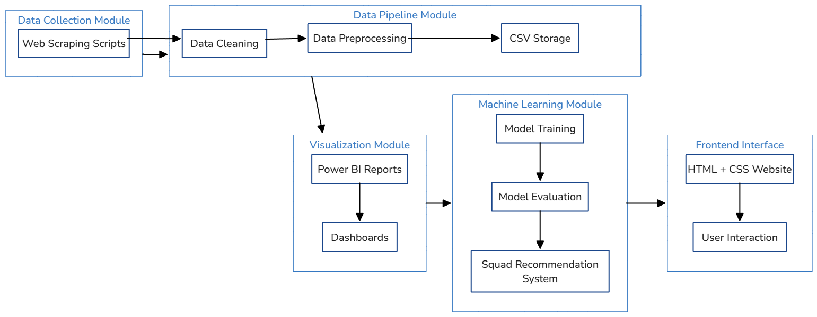
DEPARTMENT OF COMPUTER SCIENCE AND ENGINEERING
ARCHITECTURE DIAGRAM

Slide 11
DEPARTMENT OF COMPUTER SCIENCE AND ENGINEERING
MODULES
1. Data Acquisition Module
Extract structured and semi-structured data from ESPNcricinfo using Python libraries (Requests, BeautifulSoup).
Capture match details, player statistics, team compositions, and tournament information.
Implement error handling for failed requests and ensure respectful scraping practices (timeouts, headers).
2. Data Preprocessing and Management Module
Clean and normalize raw scraped data using Pandas (handling missing values, standardizing formats).
Merge multiple datasets (batting, bowling, match results, player info) into relational formats.
Store processed data into CSV and JSON files for subsequent usage.
3. Data Analytics and Modeling Module
Perform exploratory data analysis (EDA) to find batting trends, bowling patterns, and team performance indicators.
Apply machine learning algorithms to predict the best playing XI squad adhering to team composition rules.
Evaluate model performance and tune parameters for optimized predictions.

Slide 12
DEPARTMENT OF COMPUTER SCIENCE AND ENGINEERING
MODULES
4. Visualization and Dashboard Module
Design interactive dashboards using Power BI for batting analysis, bowling insights, and team comparisons.
Incorporate visualizations like bar charts, heatmaps, scatter plots, and KPI indicators.
Enable filters based on players, matches, and teams for a dynamic user experience.
5. Web Deployment and Reporting Module
Build a simple yet elegant HTML/CSS website to showcase project insights and downloadable files.
Integrate links to Power BI dashboards and present CSV/JSON summaries.
Document the entire pipeline through detailed reports, flow diagrams, and architectural visualizations.

Slide 13
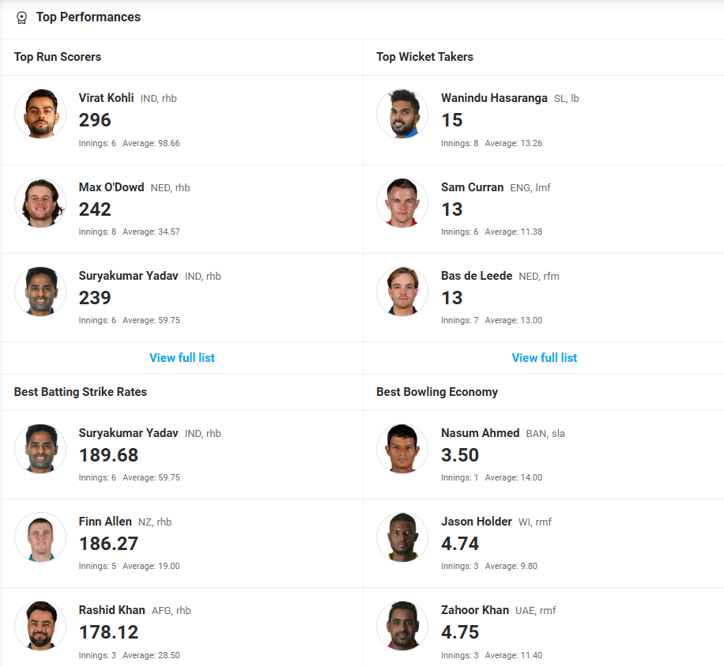
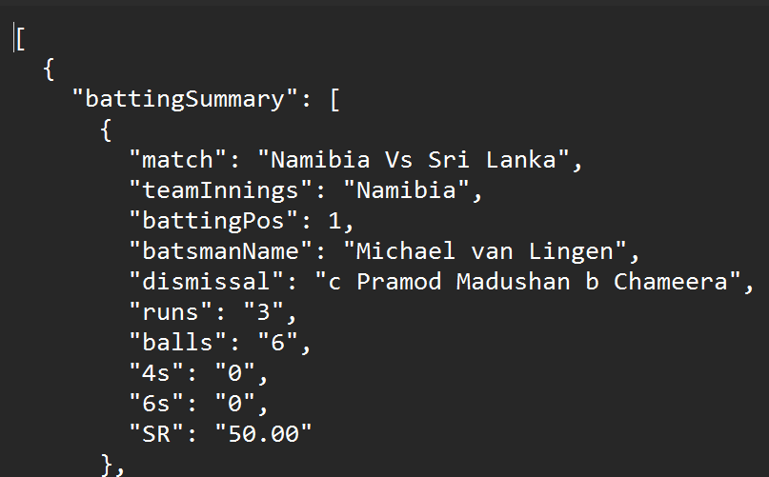
DEPARTMENT OF COMPUTER SCIENCE AND ENGINEERING
1. Data Acquisition Module
Scraped structured and semi-structured data from ESPNcricinfo tournament pages.
Extracted key fields such as player stats, match results, and team lineups.
Automated URL discovery for efficient crawling across multiple matches and player profiles.
Implemented error handling for network failures, missing data, and unexpected HTML structure changes.
Stored acquired raw data into standardized JSON and CSV formats for downstream processing.

Slide 14
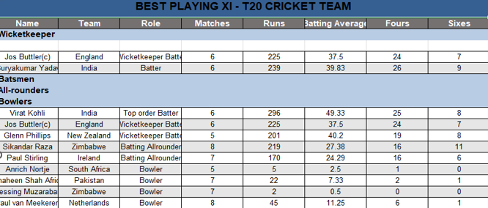
DEPARTMENT OF COMPUTER SCIENCE AND ENGINEERING
2. Data Preprocessing and Management Module
Remove inconsistencies such as missing values, duplicate records, and incorrect data formats from the raw scraped datasets.
Uniformly format columns such as player names, team names, match dates, and numerical statistics for seamless integration.
Integrate batting, bowling, player info, and match result datasets into a unified structure for holistic analysis.
Identify and fix anomalies like incomplete matches, players with partial statistics, or missing records during preprocessing.
Export clean, structured data into CSV and JSON files, maintaining clear organization for future modeling and visualization tasks.

Slide 15
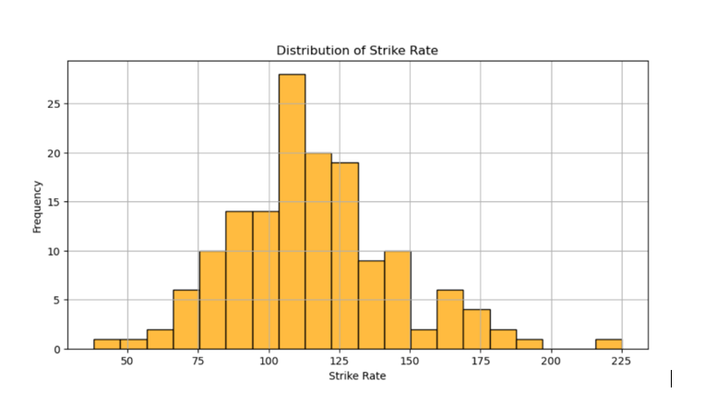
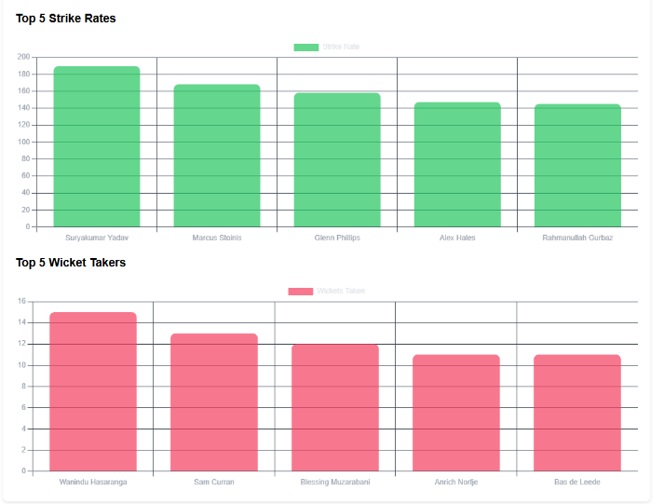
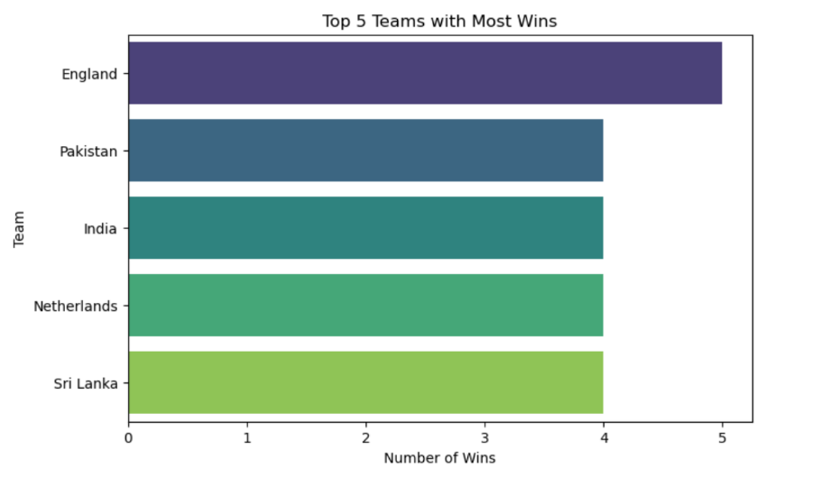
DEPARTMENT OF COMPUTER SCIENCE AND ENGINEERING
3. Data Analytics and Modeling Module
Perform detailed statistical analysis on batting, bowling, and match performance datasets.
Identify top performers using metrics like Strike Rate, Economy Rate, Wickets, and Runs scored.
Implement Machine Learning models (like Decision Trees or Random Forests) to predict the Best Playing XI.
Apply clustering algorithms to group players based on similar performance characteristics.
Validate model outputs by comparing them against actual match-winning combinations and expert opinions.

Slide 16
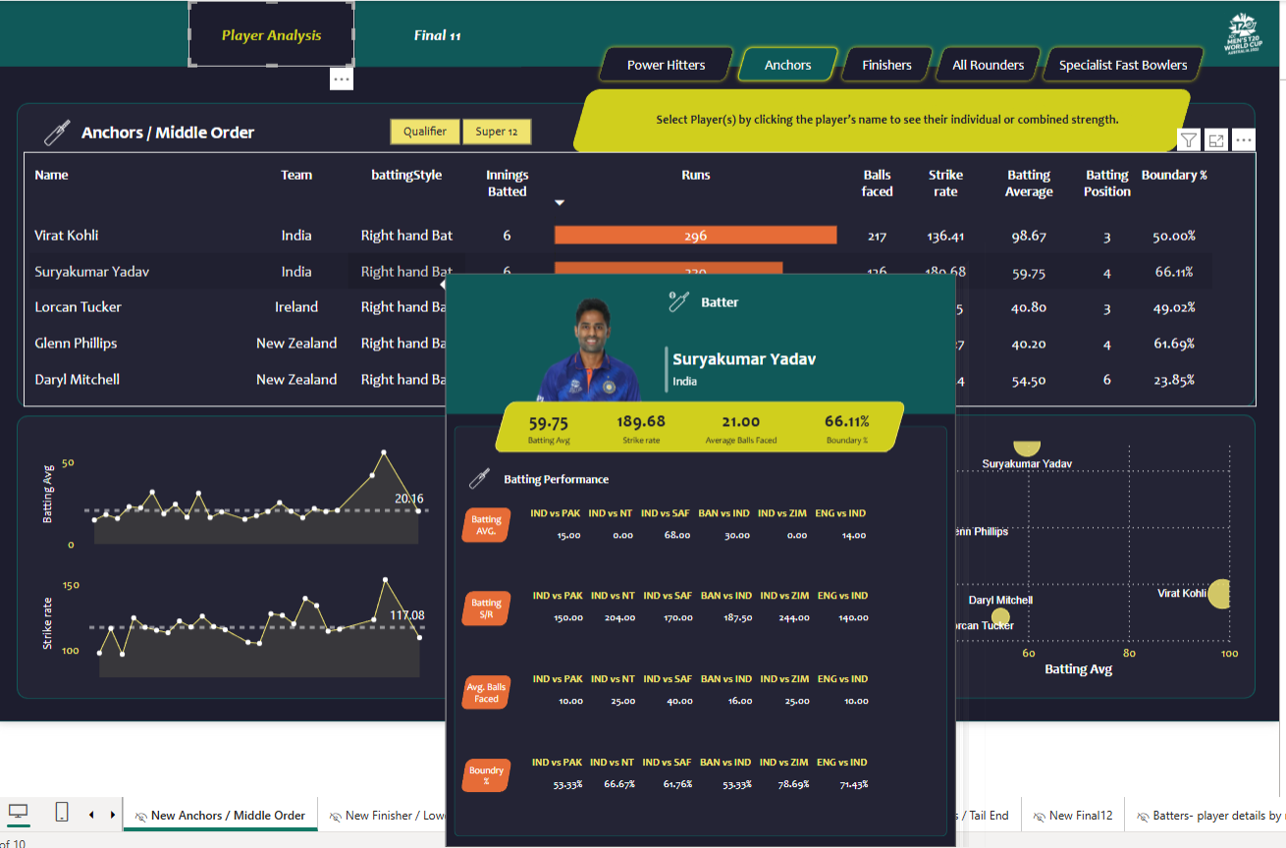
DEPARTMENT OF COMPUTER SCIENCE AND ENGINEERING
4. Visualization and Dashboard Module
Design interactive dashboards using Power BI to visualize player performances, team comparisons, and match summaries dynamically.
Create bar charts, line plots, pie charts, and heatmaps for intuitive interpretation of batting strike rates, bowling economy rates, and match results.
Implement slicers and filters in dashboards for user-driven exploration based on players, teams, and match stages.
Highlight key performance indicators (KPIs) like highest run scorers, top wicket-takers, and best economy rate bowlers with visual emphasis.
Ensure dashboards are visually appealing, mobile-friendly, and exportable for reports and stakeholder presentations.

Slide 17
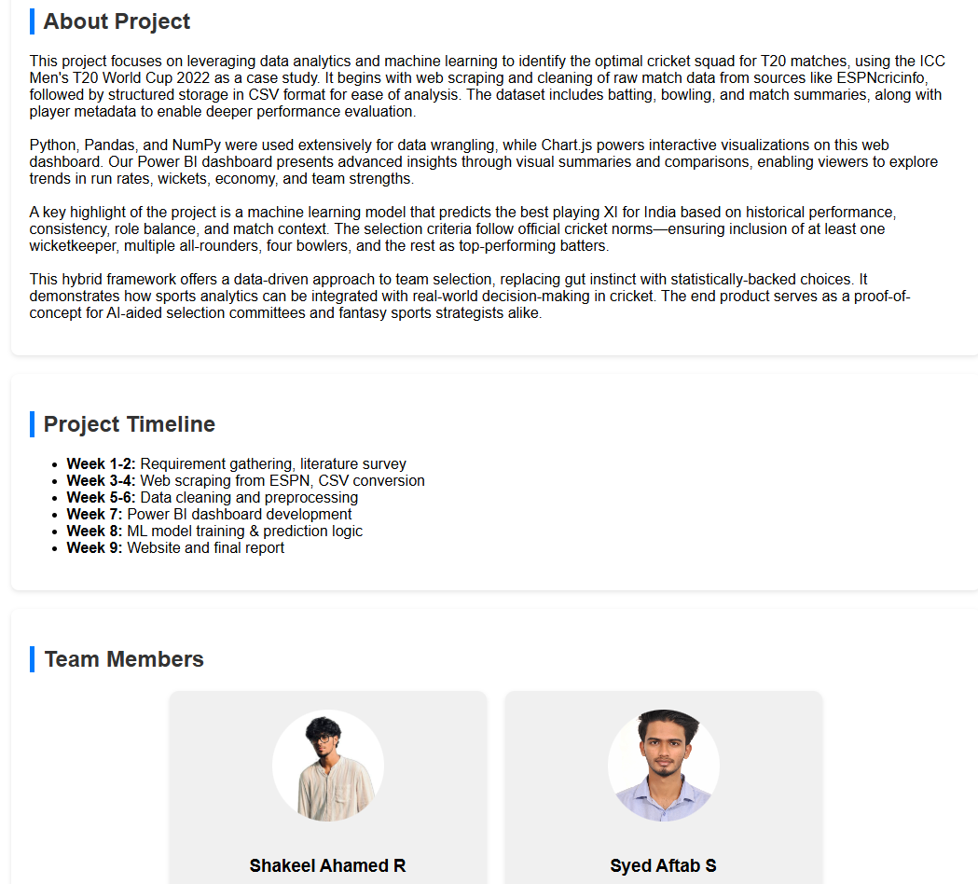
DEPARTMENT OF COMPUTER SCIENCE AND ENGINEERING
5. Web Deployment and Reporting Module
Develop a clean and responsive HTML/CSS website to present the project outcomes in a user-friendly manner.
Attach downloadable CSV, JSON files, and visual assets generated during the data processing and analysis phases.
Embed or link Power BI dashboards for interactive visualization without requiring users to open separate tools.
Host project documentation, architecture diagrams, data flow diagrams, and ER diagrams clearly for reviewer access.
Ensure smooth navigation, accessibility across devices, and proper organization of results for final project showcasing.

Slide 18
DEPARTMENT OF COMPUTER SCIENCE AND ENGINEERING
SYSTEM REQUIREMENT
Software Specification
Software/Tool | Purpose | Version/Details
Python | Web scraping, data processing, and ML modeling | Version 3.8 or above
BeautifulSoup, Requests | HTML parsing and HTTP requests handling | Latest pip versions
Pandas, NumPy | Data cleaning, transformation, and numerical operations | Latest pip versions
Scikit-learn | Machine learning algorithms for player prediction | Latest pip version
Power BI Desktop | Building dashboards and visualizations | Latest version
Anaconda / Jupyter Notebook | Code development and analysis in organized manner | Latest distribution
VS Code / PyCharm | Python code editing and debugging | Latest stable versions
Chrome / Edge Browser | Viewing web pages, testing web deployment | Updated to latest version

Slide 19
DEPARTMENT OF COMPUTER SCIENCE AND ENGINEERING
SYSTEM REQUIREMENT
Hardware Specification
Hardware Component | Minimum Specification | Purpose
Processor (CPU) | Intel Core i3 (8th Gen) / AMD Ryzen 3 or higher | To handle Python scripting, scraping, and basic analysis
RAM | 8 GB | Smooth running of scripts and Power BI
Storage | 256 GB SSD | Fast data reading/writing, enough for JSON/CSV files
Internet Connection | Stable broadband (≥ 10 Mbps) | For web scraping and dashboard access
Display Monitor | 14 inches, HD | Clear view of coding and visual dashboards

Slide 20
DEPARTMENT OF COMPUTER SCIENCE AND ENGINEERING
REFERENCES
[1]. B. Hassan, C. Clough, Y. Siddiqi, R. Faizan Ali and M. A. Arshed, "PlayerRank: Leveraging Learning-to-Rank AI for Player Positioning in Cricket," in IEEE Access, vol. 12, pp. 177504–177519, 2024, doi:10.1109/ACCESS.2024.3495528.Keywords: Sports Machine Learning; Accuracy; Prediction Algorithms; Machine Learning Algorithms; Deep Learning; Random Forests; Performance Analysis; Cricket Player Prediction; Ranking Algorithms; Learning to Rank.
[2]. Z. Pu et al., "Orientation and Decision-Making for Soccer Based on Sports Analytics and AI: A Systematic Review," in IEEE/CAA Journal of AutomaticaSinica,vol.11,no.1,pp.3–72024, doi:10.1109/JAS.2023.123807.Keywords:Tracking Loops; Systematics; Decision-Making; Taxonomy; Virtual Environments; Reinforcement Learning; Benchmark Testing; AI; Sports Analytics.
[3]. M. Soloviev, P. Aksenov, A. Skhvediani, T. Tenishev, F. Kolomenskiy and E. Bormontova, "Text Mining-Based Analysis of Content Topics and User Engagement in University Social Media,"in IEEE Access, vol. 12, pp. 150354–150371, 2024, doi:10.1109/ACCESS.2024.3474794.Keywords: Social Networking; Stakeholders; Decision Making; Analytical Models; Sentiment Analysis; Data Visualization; Topic Modeling; University Media.
[4]. C. Mou, "The Attention Mechanism Performance Analysis for Football Players Using the Internet of Things and Deep Learning," in IEEE Access, vol.12,pp4948 4957,2024,doi:10.1109/ACCESS.2024.3350036.Keywords: Sports Sensors; Big Data; Analytical Models; IoT; Deep Learning; Attention Mechanism; Football Player Performance.
[5]. J. Liu et al., "PoseCoach: A Customizable Analysis and Visualization System for Video-Based Running Coaching," in IEEE Transactions on Visualization and Computer Graphics,vol.30,no.7,pp.3180–3195, 2024, doi:10.1109/TVCG.2022.3230855.Keywords: Video Processing; Sports 48 Data Analysis; Three-Dimensional Displays; Human Pose Estimation; Data Visualization.

Slide 21
DEPARTMENT OF COMPUTER SCIENCE AND ENGINEERING
REFERENCES
[6]. Cao et al., "Team-Builder: Toward More Effective Lineup Selection in Soccer," in IEEE Transactions on Visualization and Computer Graphics, vol.29,no.12,pp.51785193,2023,doi:10.1109/TVCG.2022.3207147.Keywo rds: Sports Visualization; Lineup Selection; Trajectory Analysis; Computational Modeling; Visual Analytics.
[7]. G. Annino et al., "Assessing Sports Performances Using an Artificial Intelligence-Driven System," 2023 IEEE International Workshop on Sport, TechnologyandResearch(STAR),Cavalese,Trento,Italy,2023,pp.98103,doi :10.1109/STAR58331.2023.10302647.Keywords: Biomechanics; Stereo Image Processing; Pose Estimation; Sport Assessment; Video Analysis; Tennis; Water Polo; Roller Skating.
[8]. F. Wu and H. Chen, "The Analysis of Technical Characteristics of Badminton for Sports With Neurorobotics Under Machine Learning," in IEEEAccess,vol.11,pp.–144348,2023, doi:10.1109/ACCESS.2023.3345636.Keywords: Neurorobotics; CNNs; Badminton Action Feature Extraction; Machine Learning; Binocular Vision.
[9]. Z. Ziyi, R. Bunker, K. Takeda and K. Fujii, "Multi-Agent Deep-Learning Based Comparative Analysis of Team Sport Trajectories," in IEEE Access, vol.11,pp.4330543315,2023,doi:10.1109/ACCESS.2023.3269287.Keywor ds: Multi-Agent Systems; Trajectory Analysis; Machine Learning; Unsupervised Learning; Team Sports.
[10]. Anik, S. Yeaser, A. G. M. I. Hossain, and A. Chakrabarty, "Player’s Performance Prediction in ODI Cricket Using Machine Learning Algorithms,"Proc.4thInt.Conf.Electr.Eng.Inf.Commun.Technol.(iCEEiCT),2 018,pp.500505.Available:https://ieeexplore.ieee.org/abstract/document/86 2811.Keywords:Player Performance Prediction; Machine Learning; Random Forests; Decision Trees; ODI Cricket.

